Slide 1

OCEAN CIRCULATION

Slide 2
Forces for circulation
1. Primary Forces--start the water moving:
a. Solar Heating
b. Winds
c. Gravity
d. Coriolis
2. Secondary Forces--influence where the currents flow

Slide 3
Ocean currents
There are two type of Ocean Currents:
1. Surface Currents--Surface Circulation
These waters make up about 10% of all the water in the ocean.
These waters are the upper 400 meters of the ocean.
2. Deep Water Currents--Thermohaline Circulation
These waters make up the other 90% of the ocean
These waters move around the ocean basins by density driven forces and gravity.
The density difference is a function of different temperatures and salinity
These deep waters sink into the deep ocean basins at high latitudes where the temperatures are cold enough to cause the density to increase.

Slide 4
Ocean Gyres
A gyre is the circular rotation of water within a basin that is driven by the wind. There are three different cells of wind that blow across each hemisphere of the Earth. This continuing pattern results in a slow clockwise rotation of water across the entire hemisphere of the oceanic basin.
Global winds drag on the water’s surface, causing it to move and build up in the direction that the wind is blowing.
And just as the Coriolis effect deflects winds to the right in the Northern Hemisphere and to the left in the Southern Hemisphere, it also results in the deflection of major surface ocean currents to the right in the Northern Hemisphere (in a clockwise spiral) and to the left in the Southern Hemisphere (in a counter-clockwise spiral).
These major spirals of ocean-circling currents are called “gyres” and occur north and south of the equator. They do not occur at the equator, where the Coriolis effect is not present.
There are five major ocean-wide gyres—the North Atlantic, South Atlantic, North Pacific, South Pacific, and Indian Ocean gyres. Each is flanked by a strong and narrow “western boundary current,” and a weak and broad “eastern boundary current”.

Slide 5
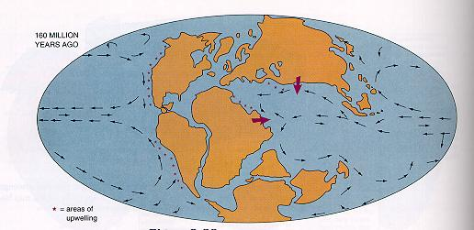
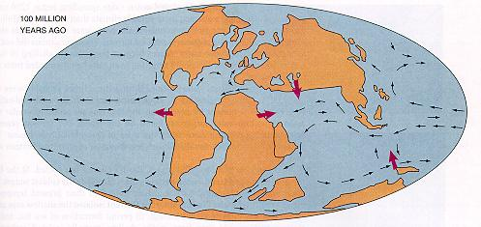
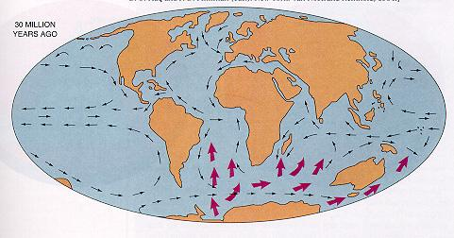
160 million years ago
100 million years ago
30 million years ago
https://earth.usc.edu/~stott/Catalina/Oceans.html

Slide 6
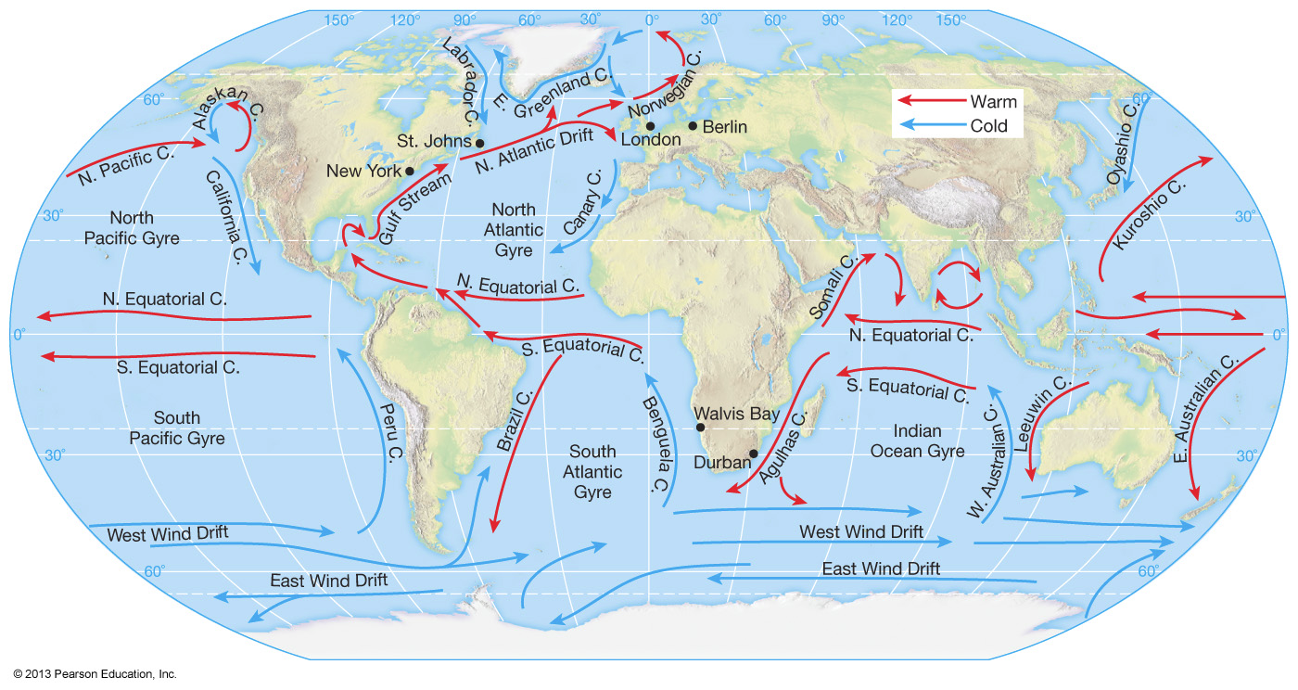

Slide 7
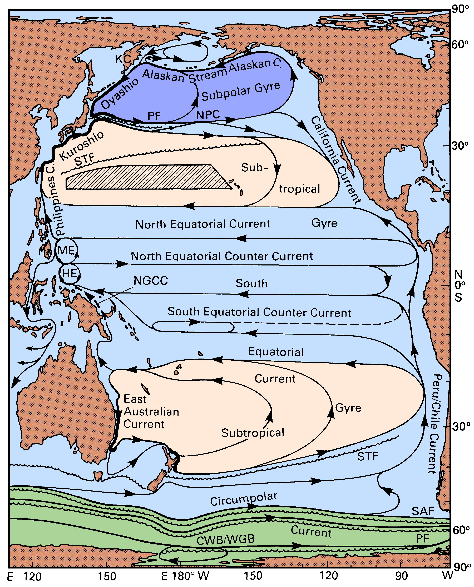
Pacific Ocean
https://www.mt-oceanography.info/regoc/pdffiles/colour/double/08P-Pacific-right.pdf

Slide 8
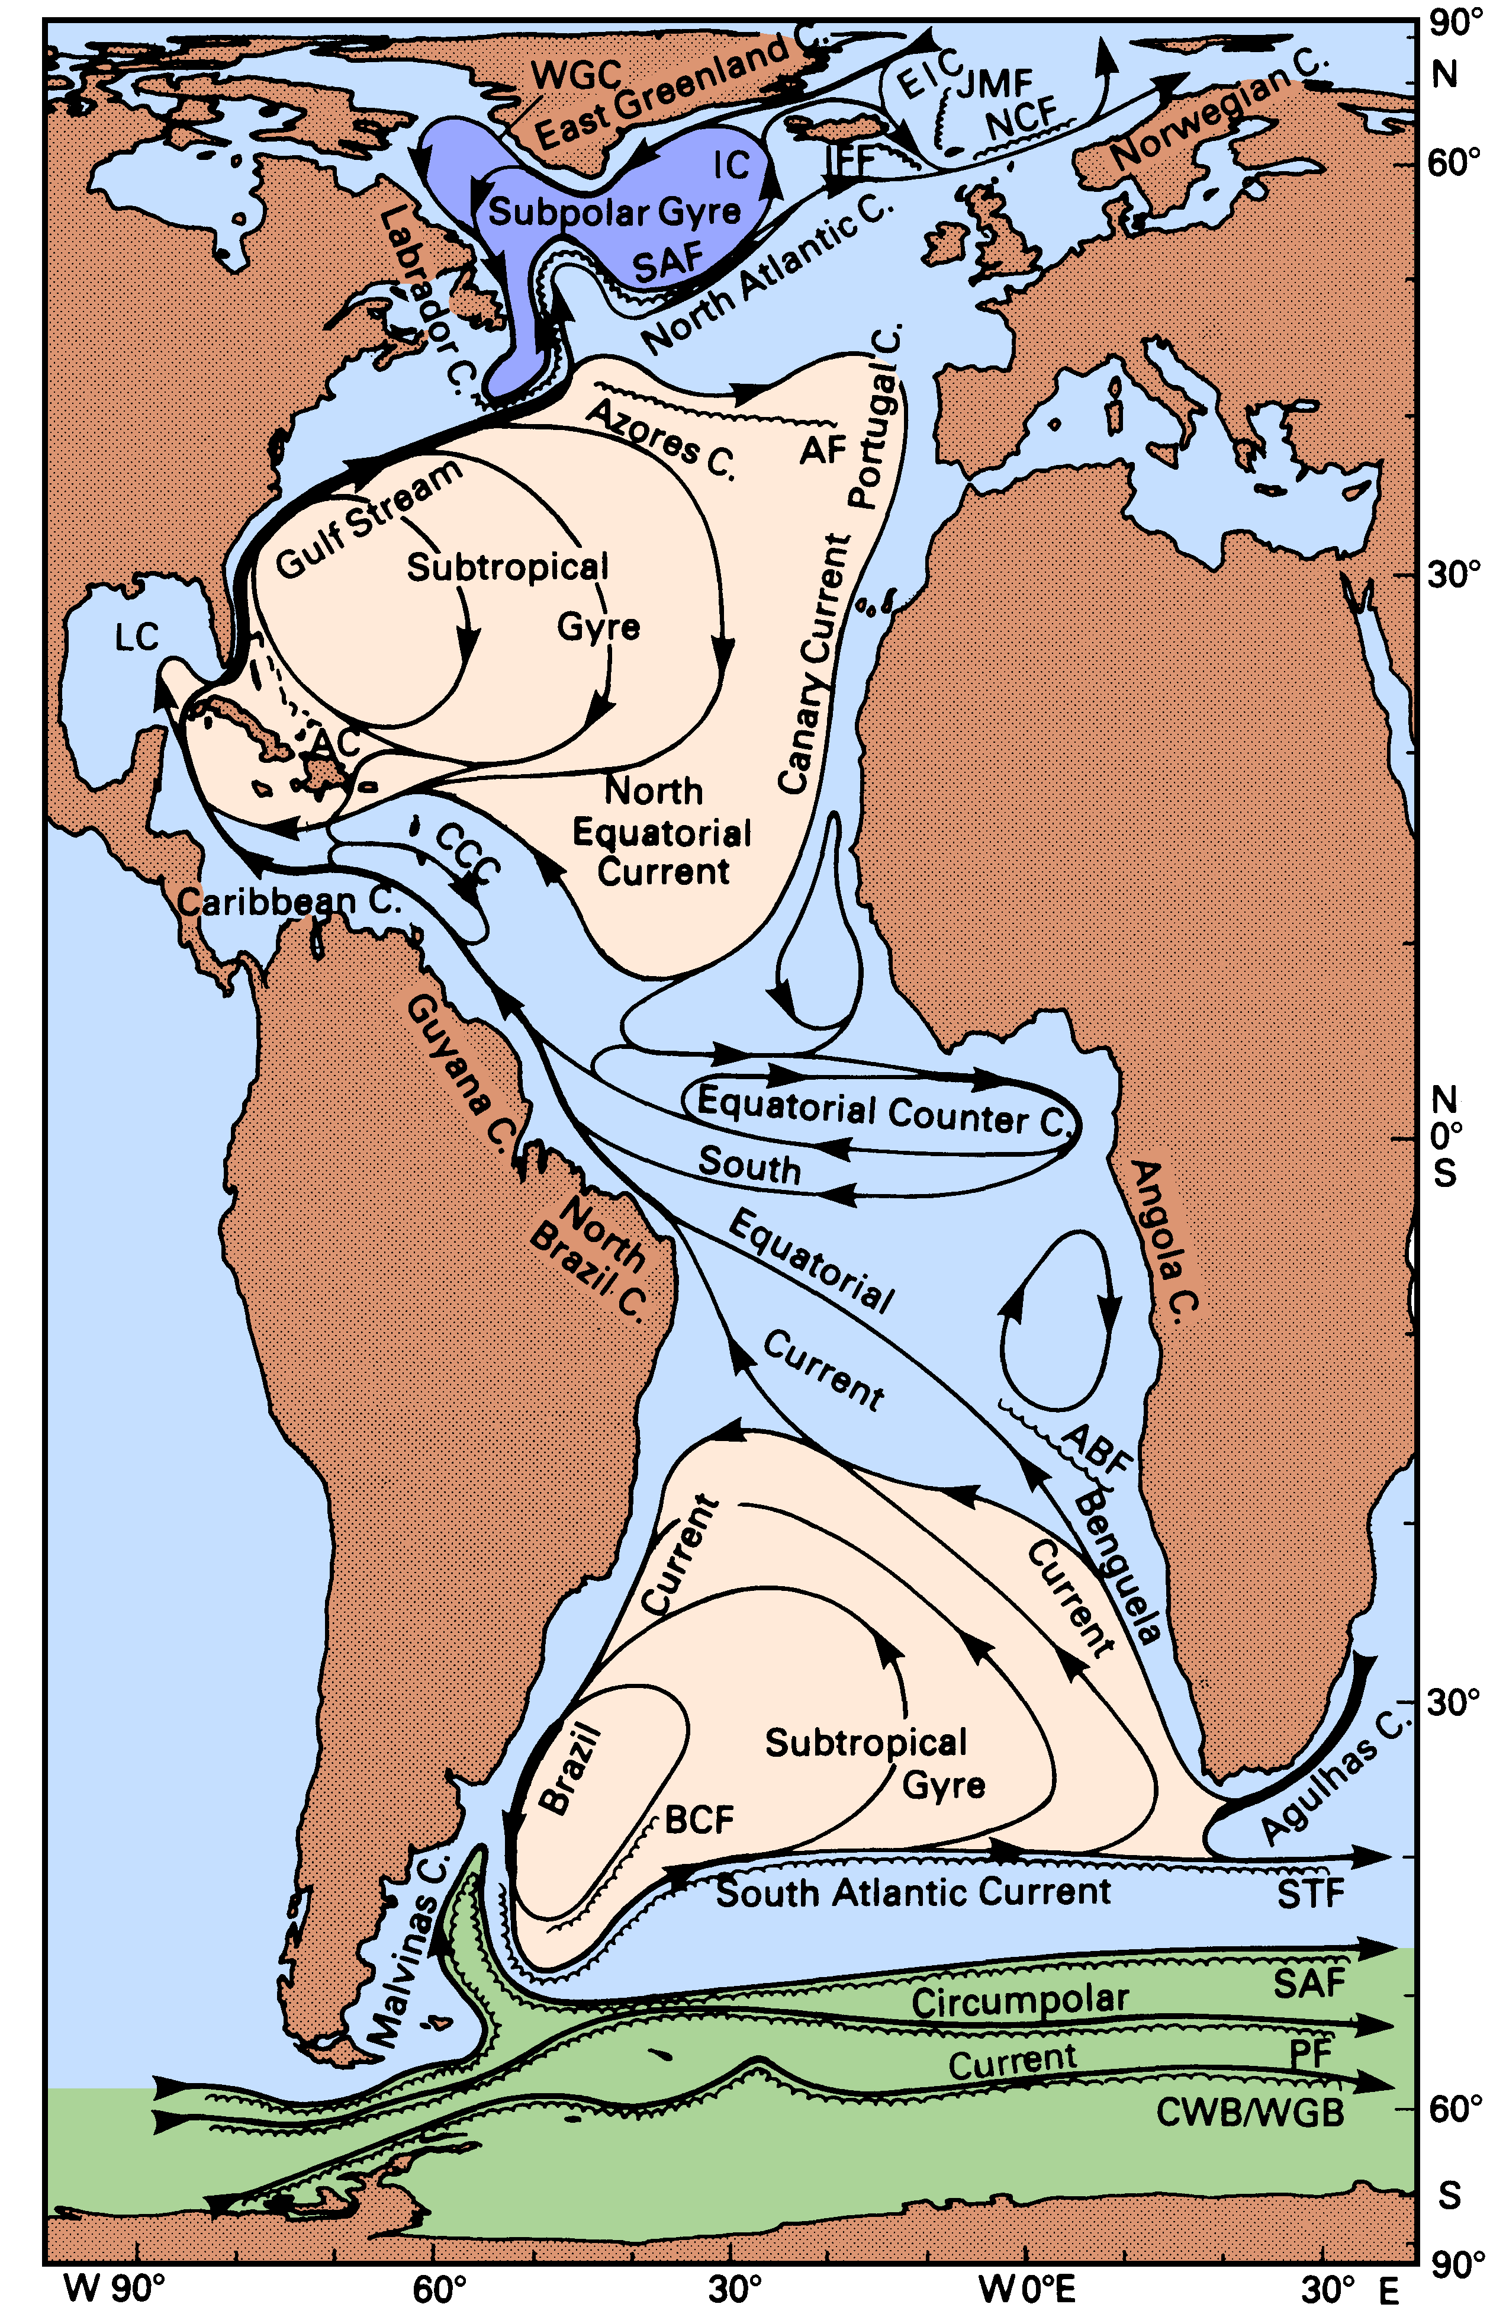
Atlantic Ocean
https://www.mt-oceanography.info/regoc/pdffiles/colour/double/14P-Atlantic-right.pdf

Slide 9
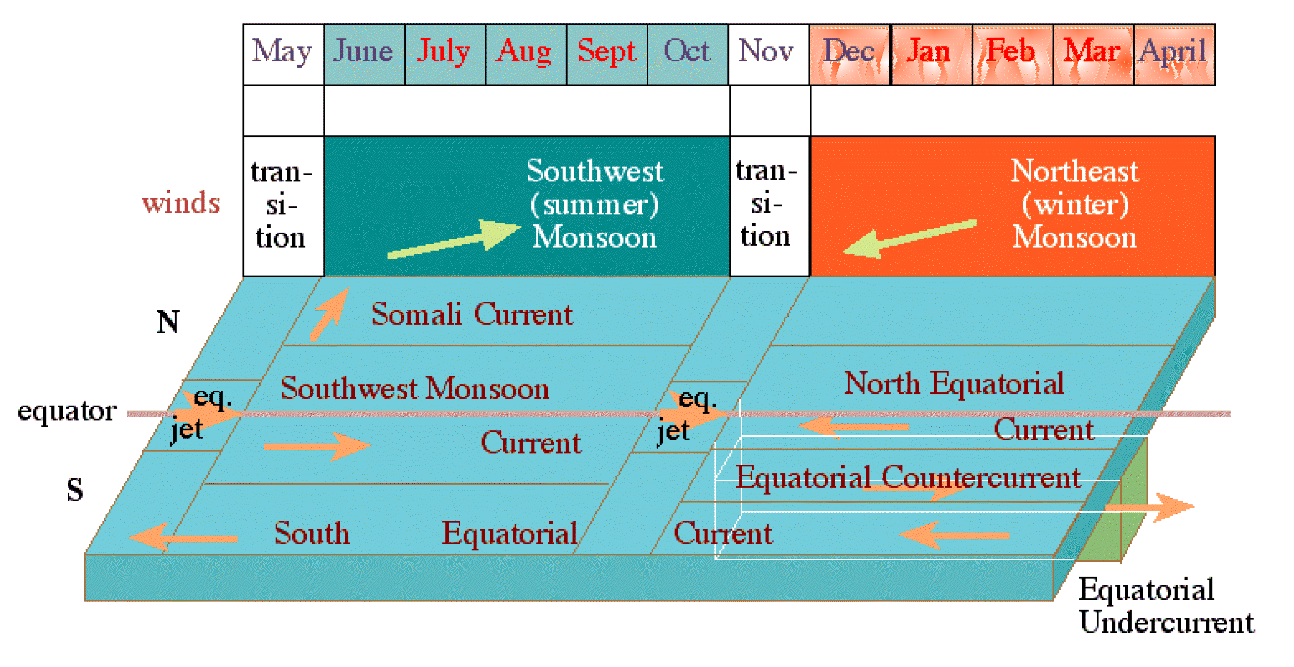
Indian Ocean
Regional Oceanography: An Introduction by Tomczak and Godfrey

Slide 10
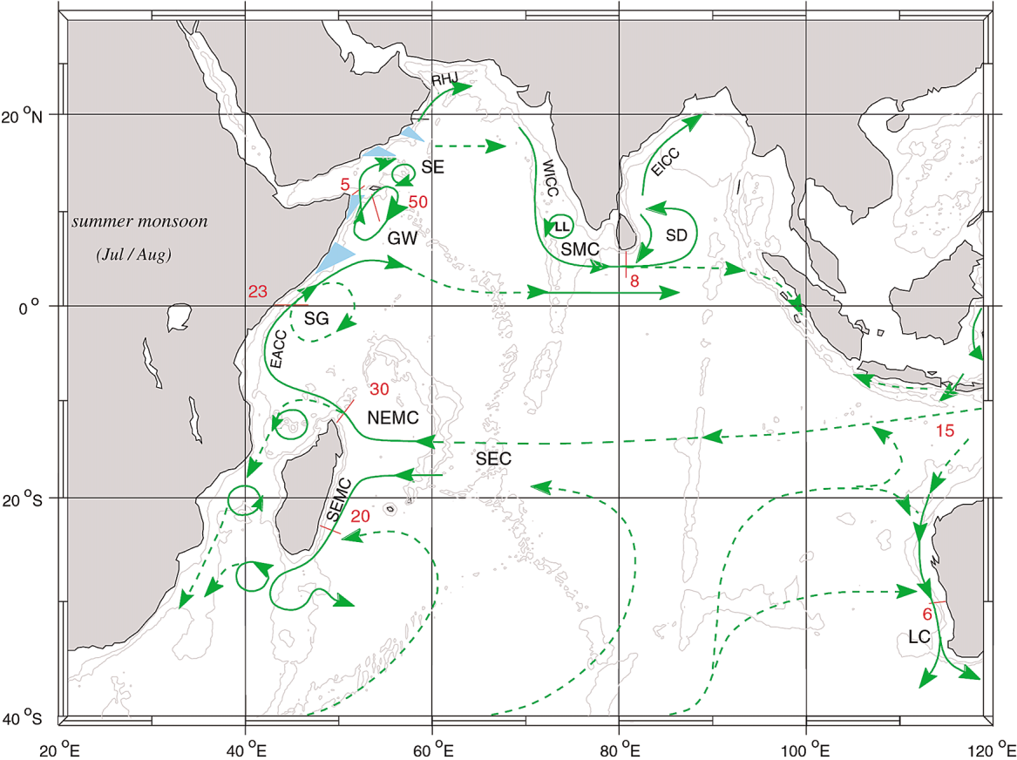

Slide 11
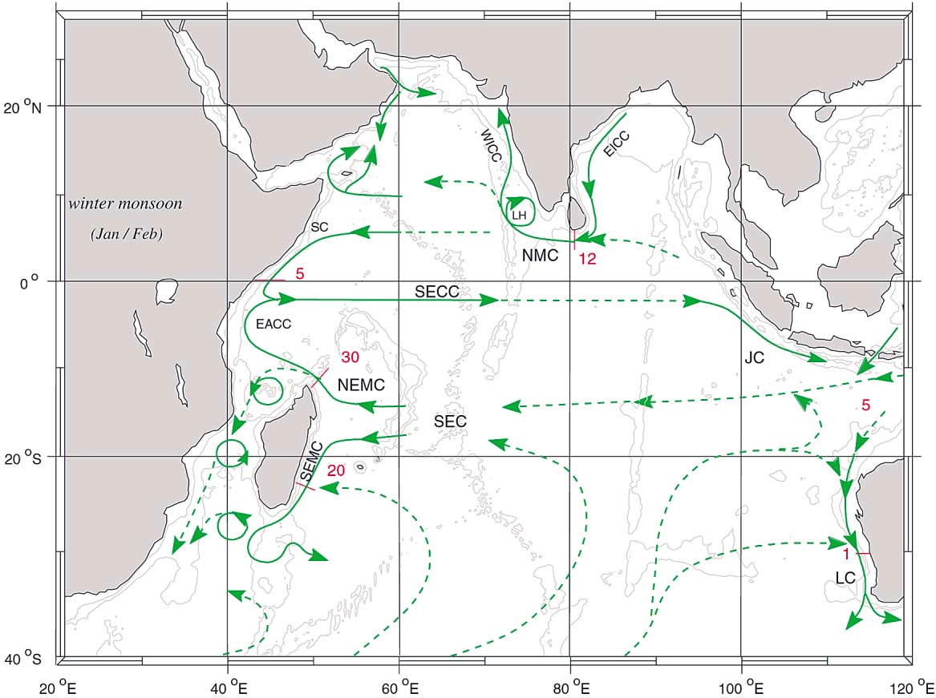

Slide 12
The constant circulation combined with the Coriolis effect has a tendency to draw water towards the center of the gyre, almost like the rotation in your toilet, almost.
Essentially pulling garbage and anything floating in the water towards the middle.
All of the garbage simply floats around breaking into smaller and smaller pieces, but never goes away. However, gyres also extremely important to help spread eggs and larvae around the Ocean.
Certain species rely on the currents from gyres to help spread their young into new water so that they do not end up competing for space in the future.

Slide 13
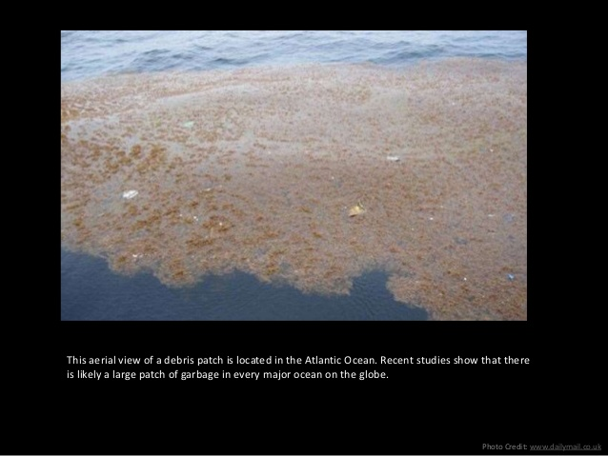

Slide 14
